Slide 1
Chapter 1: Introduction to Statistics

Slide 2
What is Statistics?
Statistics is the science of collecting, organizing, analyzing, and interpreting data in order to make decision

Slide 3
What Is Statistics?
Data
Analysis
Why?
1. Collecting Data
  e.g. Survey
2. Presenting Data
  e.g., Charts & Tables
3. Characterizing Data
  e.g., Average
© 1984-1994 T/Maker Co.
Decision-
Making
Introduction/Saikhu
© 1984-1994 T/Maker Co.
Notes:
:1, 1, 3

Slide 4
Variables
A variable is a characteristic or condition that can change or take on different values.
Most research begins with a general question about the relationship between two variables for a specific group of individuals.

Slide 5
Population
The entire group of individuals is called the population.
For example, a researcher may be interested in the relation between class size (variable 1) and academic performance (variable 2) for the population of third-grade children.

Slide 6
Sample
Usually populations are so large that a researcher cannot examine the entire group. Therefore, a sample is selected to represent the population in a research study. The goal is to use the results obtained from the sample to help answer questions about the population.

Slide 7
Important Terms
Parameter:
A number that describes a population characteristic.
Average age of all people
in the United States
Statistic:
A number that describes a sample characteristic.
Average age of people from a sample of three states.
Introduction/Saikhu
Notes:
These terms are used throughout the course. The arrows at the end, emphasize the connection between population parameter and sample statistic.

Slide 8
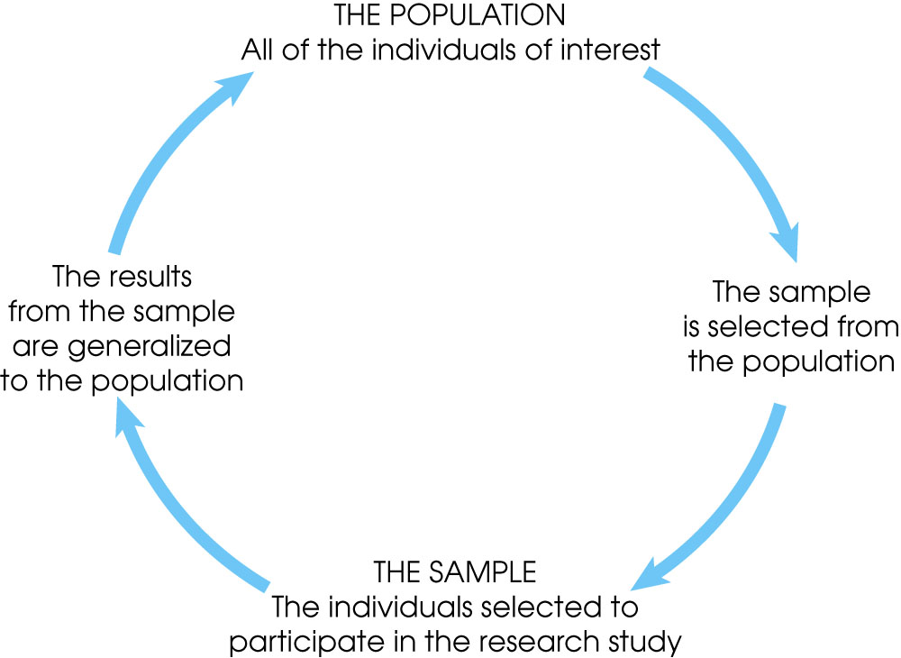
Notes:
Figure 1.1
The relationship between a population and a sample.

Slide 9
Types of Variables
Variables can be classified as discrete or continuous.
Discrete variables (such as class size) consist of indivisible categories, and continuous variables (such as time or weight) are infinitely divisible into whatever units a researcher may choose. For example, time can be measured to the nearest minute, second, half-second, etc.

Slide 10
Real Limits
To define the units for a continuous variable, a researcher must use real limits which are boundaries located exactly half-way between adjacent categories.

Slide 11
4 Types of Measurement Scales
A nominal scale is an unordered set of categories identified only by name. Nominal measurements only permit you to determine whether two individuals are the same or different.
An ordinal scale is an ordered set of categories. Ordinal measurements tell you the direction of difference between two individuals.

Slide 12
4 Types of Measurement Scales
3. An interval scale is an ordered series of equal-sized categories. Interval measurements identify the direction and magnitude of a difference. The zero point is located arbitrarily on an interval scale.
4. A ratio scale is an interval scale where a value of zero indicates none of the variable. Ratio measurements identify the direction and magnitude of differences and allow ratio comparisons of measurements.

Slide 13
Correlational Studies
The goal of a correlational study is to determine whether there is a relationship between two variables and to describe the relationship.
A correlational study simply observes the two variables as they exist naturally.

Slide 14
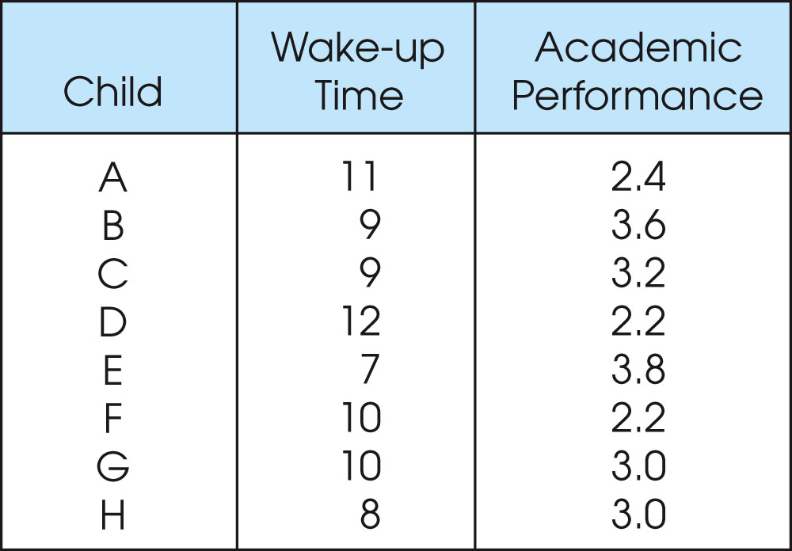
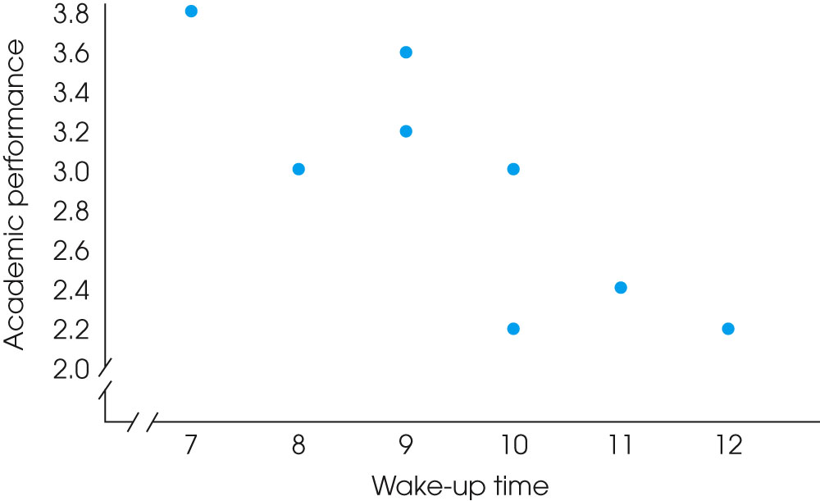
Notes:
Figure 1.4
One of two data structures for studies evaluating the relationship between variables. Note that there are two separate measurements for each individual (wake-up time and academic performance). The same scores are shown in a table (a) and in a graph (b).

Slide 15
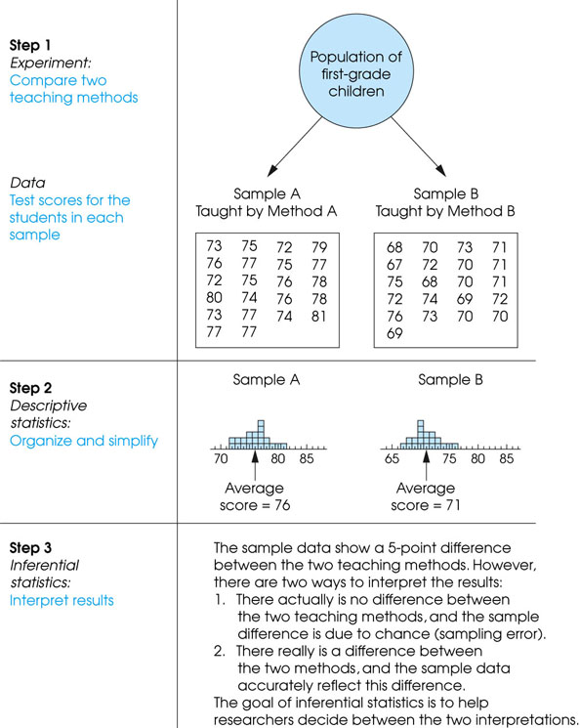
Notes:
Figure 1.3
The role of statistics in experimental research.

Slide 16
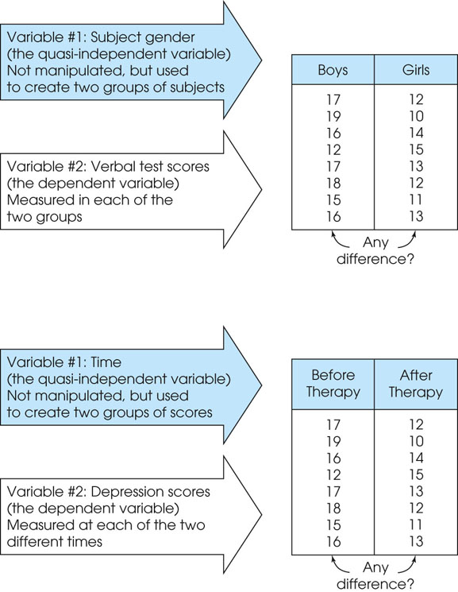
Notes:
Figure 1.7
Two examples of nonexperimental studies that involve comparing two groups of scores. In (a) the study uses two preexisting groups (boys/girls) and measures a dependent variable (verbal scores) in each group. In (b) the study uses time (before/after) to define the two groups and measures a dependent variable (depression) in each group.

Slide 17
Data
The measurements obtained in a research study are called the data.
The goal of statistics is to help researchers organize and interpret the data.

Slide 18
Descriptive Statistics
Descriptive statistics are methods for organizing and summarizing data.
For example, tables or graphs are used to organize data, and descriptive values such as the average score are used to summarize data.
A descriptive value for a population is called a parameter and a descriptive value for a sample is called a statistic.

Slide 19
Inferential Statistics
Inferential statistics are methods for using sample data to make general conclusions (inferences) about populations.
Because a sample is typically only a part of the whole population, sample data provide only limited information about the population. As a result, sample statistics are generally imperfect representatives of the corresponding population parameters.

Slide 20
Sampling Error
The discrepancy between a sample statistic and its population parameter is called sampling error.
Defining and measuring sampling error is a large part of inferential statistics.

Slide 21
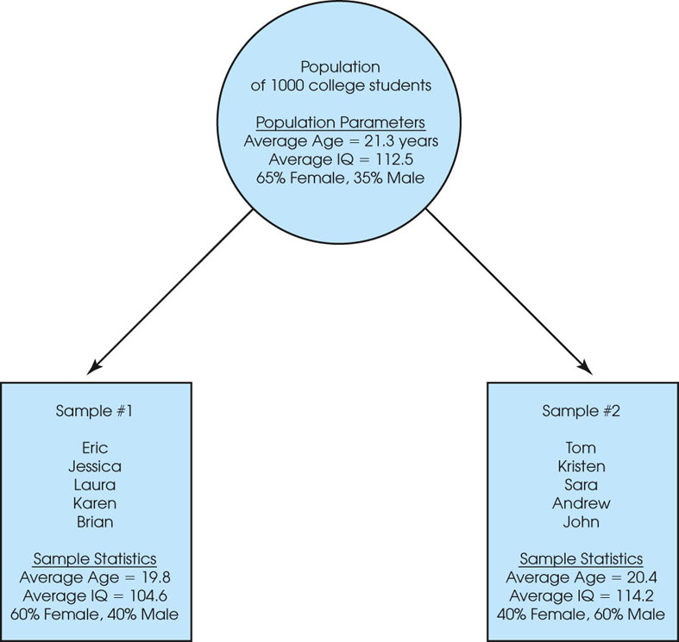
Notes:
Figure 1.2
A demonstration of sampling error. Two samples are selected from the same population. Notice that the sample statistics are different from one sample to another, and all of the sample statistics are different from the corresponding population parameters. The natural differences that exist, by chance, between a sample statistic and a population parameter are called sampling error.

Slide 22
Notation
The individual measurements or scores obtained for a research participant will be identified by the letter X (or X and Y if there are multiple scores for each individual).
The number of scores in a data set will be identified by N for a population or n for a sample.
Summing a set of values is a common operation in statistics and has its own notation. The Greek letter sigma, Σ, will be used to stand for "the sum of." For example, ΣX identifies the sum of the scores.

Slide 23
Order of Operations
All calculations within parentheses are done first.
Squaring or raising to other exponents is done second.
Multiplying, and dividing are done third, and should be completed in order from left to right.
Summation with the Σ notation is done next.
Any additional adding and subtracting is done last and should be completed in order from left to right.

